Slide 1
Digital Investment Facility
Data Governance in Africa

Slide 2
The initiative at a glance
Integrated approach
for greater impact
01/23 – 07/26
Objective: Supporting the human-centric data economy and society in Africa, in line with the AU Data Policy FW
Action on continental, national and regional level
Implemented by:
GIZ
HAUS
Enabel
Expertise France
Digital Africa
ESTDEV
Co-financed by:
EU
Germany
Finland
Belgium
France
Estonia
I Data policy and regulation
II Data value creation and cross border data flows
III Data Infrastructure
EU-AU Strategic Partnership: Digital Cooperation

Slide 3
3 Pillars - Specific Objectives
Data Policies & Regulations
Data Use Cases & Cross Border Flows
Digital Investment Facility
Enabling environment for investments into African data infrastructure improved
Investment opportunities for green and secure data infrastructure projects identified in priority regions
Bankable investment opportunities for green and secure data infrastructure projects are accepted for consideration by financiers
Enhanced mechanisms for harmonizing and monitoring progress of data strategies, policies and regulations at continental and regional level
Strong, comprehensive and harmonised data governance instruments developed or updated
Cross-border data flows and enhanced use of data enabled
Innovative regulatory approaches for the enhanced use and sharing of data co-developed and tested
Enhanced multistakeholder capacity in scaling up data-driven Digital Social Innovations (DSIs)
Increased ability of regional and national institutions, CSOs and Private Sector entities to access, analyse, use and share data for value creation
Notes:
Regulation: a) National Stategies, AI strategy, cross-domain digital strategies b) capacity building
Use cases based on Data Space: Agriculture, Cattle, Climate, City

Slide 4
Promoting enhanced partnerships for investments in green and secure data infrastructure
While hosting 17% of the world population, Africa currently accounts for less than 1% of the world’s co-location data centre capacity […] This is a constraint to the emergence of a value-creating digital economy in Africa.
Xalam Analytics, 2020
Digital Investment Facility (DIF)
The African Data Centre market is expected to exceed US$ 3 billion by 2025 and grow at a compound annual growth rate of 12% between 2020 and 2026.
Oxford Business Group
While investment opportunities are bright,, development challenges are broadly acknowledged by key players: there is a lack of bankable investment proposals on digital infrastructure in Africa.
Fact Finding Missions (TEI Partners - 2022)

Slide 5
DIF Value-Added Pipeline for Bankable Projects
Initiative dedicated solely on understanding development & financing data infrastructure projects in Africa.
Project preparation that brings investment ready projects.
Promote a conducive environment of data markets and investments at national, regional and continental level.
Harmonised, integrated approach combining infrastructure to data value-creation and policy/regulatory reform.
Unique access to Data Ecosystem role-players in EU and Africa from policymakers, CSOs to private sector.
Convening power to involve key partners from Europe and Africa in multi-stakeholder process under EU-AU Strategic Partnership on Digital Cooperation in line with EU Global Gateway Strategy.
Leverage network of experts for data gathering and market intelligence on data infrastructure
Play a key role in building a knowledge base and models that enable investment in bankable data centre projects.
4

Slide 6
Which eligibility criteria will be applied?
Investment Size Criteria
Aggregated investment size over 5-10 years
Focus on Data Infrastructure Solutions
Primary focus on Data Centres and Internet Exchange Points
Revenue Generation
Minimum ticket size: EUR 5 Million
Includes data storage, management, processing, and retrieval
Investments may extend to Data Aggregation, Analytics, Monetization, Privacy, and Security.
Clearly state value proposition and main clients/tenants.
Must meet minimum economic viability and sustainability threshold.
Proposals should emphasize revenue generation.
Services should complement client resources and be valued by financiers.
Location Eligibility
Project Promoters must be located or licensed in developing/emerging countries in sub-Saharan Africa.
Involvement of Private Sector
Eligible Promoters: private sector developers, NGOs, universities, parastatal companies, government, or research institutions.
Climate Action Potential and ESG Compliance
Project aims for ambitious contribution to greenhouse gas emissions mitigation (Paris Agreement) and/or climate change adaptation.
Compliant with ODA-OECD DAC list and potentially BMZ 2030 list.
Must meet high environmental, social, and governance standards.
Clear estimation of proposal's impact required, demonstrating additionality and public benefit.
Projects should show significant private-sector ownership for financing with debt/equity.
Private-sector engagement can develop during advisory support.
DIF will evaluate projects on both on the “concept” and “Idea” level proposals
→ the DIF Coordination team will formulate an individualised project advisory package reflecting the advisory needs and respective maturity of an applicants’ project dossier.
These are the criteria based on which projects will be evaluated:
Request Status Criteria
Requests must be in design/definition, pre-feasibility, or financial structuring stage.

Slide 7
DIF Service Mechanism → Preparing public and private investment pipelines
Enabling Environment Policy Advice
Assessment of regulatory environment and value-creation initiatives
Market Advisory
Market insight and investor country briefs for European EDFIs and MDB
Capacity building for African promoters on infrastructure business models, EU cybersecurity and environmental standards
Technical guideline(s) on green and secure data infrastructure
Investment opportunities: from ideas to pre-evaluated proposals
What are the potential investment projects?
Data Infrastructure = data processing capacities and services; new and existing data centres (enterprise, colocation, managed service, cloud services), incl. hardware, operational software; national internet exchange points.
What type?
Green and brown field
Green and secure = high level of environmental and energy-efficiency and EU cybersecurity standards
At what cost?
No cost to project owners and financial institutions
5

Slide 8
DIF Project Advisory Service Model
Coaching and advisory provided to project developers and promoters through the DIF is at the heart of the Service Model
How?
Advisory services on integrated project design, i.e. pre-feasibility for African promoters/developers
Facilitation of European investment opportunities in public-purpose projects, utilising EFSD+ blended finance
Liaison – honest broker between European EDFIs / MDB and European and African industry
Support on / hand-over of funding applications to European financing institutions and investors
Result: high-quality project proposals turned into bankable investments
Technical Assistance Services
Technical Design
and Review
Business, financial plan review and project organizational setup
Pre-Feasibility
Study
Project promotion strategy and fund-raising support
Financial Structuring and Closing Support
6

Slide 9
Top Tier Expert Profiles Available for Advisory Services
Project Director
Financial Advisor
Data Infra Expert
Network Expert
Transmission Expert
Environment, Social and Government (ESG) Expert
ICT Consultant
Local ICT Experts (4-6)

Slide 10
How do we work on incoming requests? (I)
Project Proposal
Request & EoI
Investment Dialogue
TA process launch
Project Proposal
A project promoter, public authority or private company needs advice on how to develop a green and secure infrastructure project. This can come through liaison of Action’s donors or through direct request to the DIF team.
Request and Expression of Interest
A formal request for project support is submitted to the DIF. In a first step, the DIF will host a consultation hour for preliminary assessment of eligibility of the Expression of Interest (EoI).
Investment Dialogue
DIF staff and applicants present request to EDFIs, MDBs, INTPA. Investor(s) voice(s) opinion(s) / recommendation(s) for assessment of request, either: go-ahead, back to pipeline or rejection.
Technical Assistance Process Launch
If TA is requested and the request fulfils the DIF’s eligibility criteria, the DIF proceeds with internal approval for technical resources and a budget will be allocated to the project. This consists of advisory on project design, pre-feasibility study, and support in financial structuring. A DIF advisor will act as sole focal point throughout the process.
8

Slide 11
HAUS or GIZ signs
How do we work on incoming requests? (II)
Hand-over
Service Agreem-ent
External Consulta-ncy
Delivery and Monitoring
Handover
Service Agreement
DIF Advisor in coordination with lead investors and donors provide the terms of reference and an agreement is signed between the DIF
and the project promoter.
External Consultancy
Based on the assignment needs, external consultants can be provided by the DIF, if necessary.
Delivery and Monitoring
Contract outputs for the TA delivery are checked by the DIF, promoters and lead investor(s). The DIF facilitates the hand-over of project proposal to lead investor(s) and wraps up assignment successfully. The DIF hands over the evaluated proposal to the lead investor(s’) pipeline.
9

Slide 12
The DIF service provision covers Sub-Saharan Africa DIF service provision will cover Sub-Saharan Africa, in line with DIF donors’ partner countries in the regions as well as in line with the rest of the Action (in total 49).
Geographical Scope
of DIF
Legend:
Team presence
Regions eligible for support
… to foster a conducive environment.
*This geographical map is for informational purposes only and does not constitute recognition of international boundaries or regions; GIZ/HAUS make no claims concerning the validity, accuracy or completeness of the maps nor assumes any liability resulting from the use of the information therein.

Slide 13
Practitioner’s Guide on Green Data Centers
The guide covers six critical dimensions that practitioners can consider to green data centres:
​climate-resilient data centres
sustainable design and buildings
sustainable ICT
sustainable energy
sustainable cooling
e-waste management
Click me
12

Slide 14
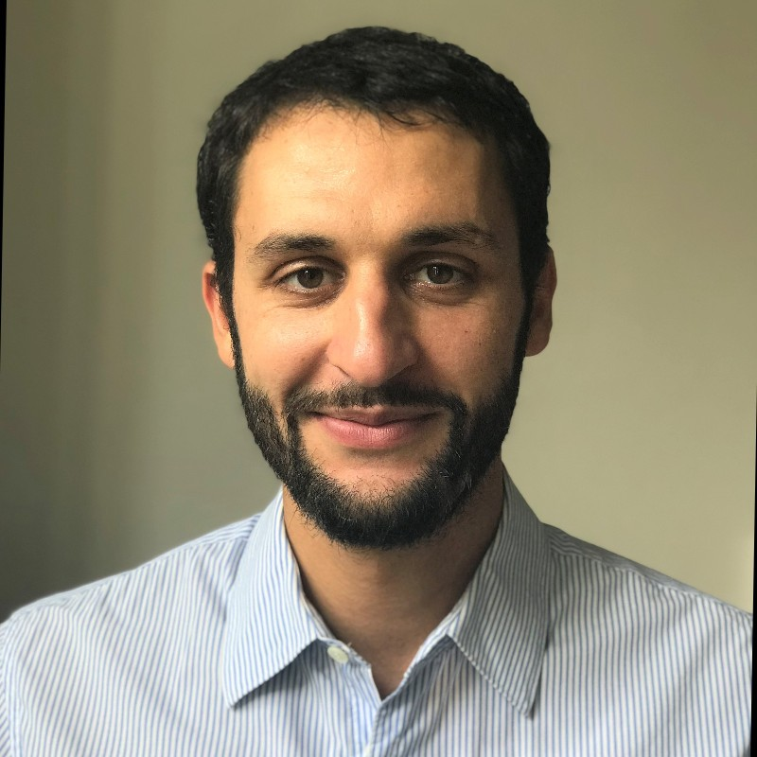
Contact SO3: Digital Investment Facility
Ilari Lindy
SO3 Lead | HAUS Team Leader
Digital Investment Facility
Data Governance in Africa Initiative
ilari.lindy@haus.fi
Yassin Bendjebbour
GIZ Team Leader
Digital Investment Facility
Data Governance in Africa Initiative
yassin.bendjebbour@giz.de
11

Slide 15
Implemented by

